Slide 1
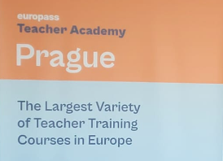
Consorțiu local pentru educație de calitate
F2 : ”Leaderships și Management”
Coaching and Mentoring to Support Teachers
Praga, 5-10 noiembrie2023
Beneficiari:
Școala Profesională Dagâța- director adjunct
Școala Gimnazială ”Ctin Teodorescu”Războieni- director adjunct

Slide 2
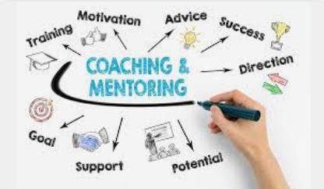
Coaching
How to unlock potenciAl in someone

Slide 3
Agenda
 | Topic | Notes
 | Introduction – who am I, who are you?
 | Coaching example with participant. Circle of life excercise, scales
 | Circle of life excercise, scales - continuation Coaching session basic structure, Powerful questions, SMART actions | Ask participants - what part of coaching session seems to be most daunting/difficult? Why? What other Powerful questions come to mind? Were you ever asked a really powerful question? Show quick coaching on one participant.
 | Looking for values – techniques Write your own epitaph | Why do we work with values in coaching?
 | Coaching in 3 – 10 min per coaching, 1 person is observer
 | Coaching example with participant | What questions we can use to help coachee to visualization the goal?
 |  | How was coaching for you? What did you noticed as observer? Was it easy to stay out of the topic? What interesting question did you heard today?

Slide 4
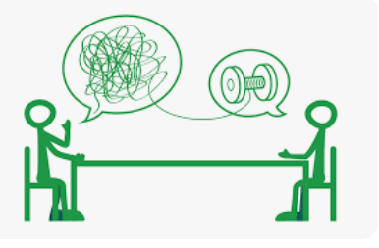
Coaching principles
Believe in Human Potential for Greatness Fulfillment Flows from Adding Value to Others Bring Out the Best in People and Let Them Lead Use Influence Rather than Position Thrive on Challenges and Flexibility When We Grow Others, We Grow Ourselves A Coach Still Needs a Coach Relationship and Trust

Slide 5
Coaching session- basic
Setup a safe space and report
Set up expectations: what would you like to have at the end of this coaching session?
Visualize: how the desired future looks like?
Reality check: where you are now?
Determine actions to take from Now to future: what you need on order to get from Now to Desired future?
Agree on actions and set up deadlines, next checks: what can you do in next day/week? What will you do? What happens if you don‘t do it
– goal
– reality check
- opportinities
- will

Slide 6
What is the theme/ topic?
- circle of life
Check the Willl
- SMART actions
W
G
Set up the goal
- visualization
- devil‘s advocate
O
R
Check the opportunities
- Milestones
Check the reality
- scaling

Slide 7
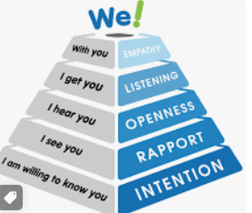
Powerful questions
Be curious about the problem, ask questions and don‘t asume that you know the solution Avoid Judgmental and Advice-Oriented Asking Great Questions Requires Practice
Open questions help to dig deeper into the problem

Slide 8
SMART actions

Slide 9
The Power of visualization
How motivated you aretoachieve this goal?
It sounds great, I can‘t wait to achieve it!
How motivated you aretoachieve this goal?
I guess it i ok…

Slide 10
The Power of visualization
Why is important, how can we achieve it?
What questions will help to visualize?
Notes:
When working towards desired future, hep coachee to describe it
Use senses: how does it feel, smell, taste, look, what do you hear.
More specific, more motivation the coaches will have to achieve it

Slide 11
Coaching techniques
Devil’s advocate
To double check the relevance of the goal
What would happen if you don’t reach this goal?
Why should you achieve this?
How is this important?

Slide 12
Coaching techniques
Circle of life
What are important parts of your life
Scale
Identify 1-2 that could be better

Slide 13
Coaching techniques
Hell’s management
For the search of Values
If you were manager of hell, how would you make the given situation worse?
How would you make your school/class the worse?
Notes:
Helps to find clients values through what they are not.

Slide 14
Coaching techniques
Epitaph
For the search of Values
What would you like people to say about you in your epitaph?

Slide 15
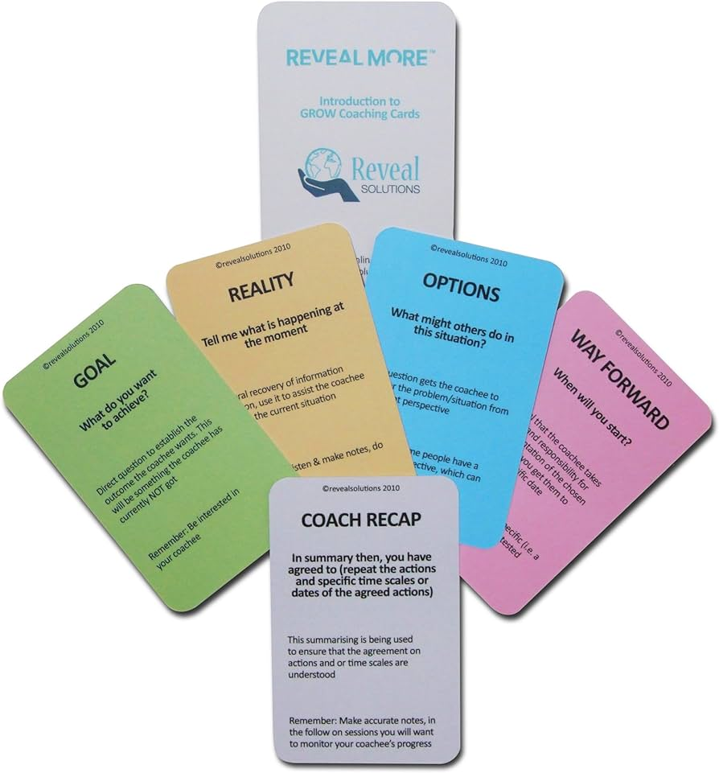
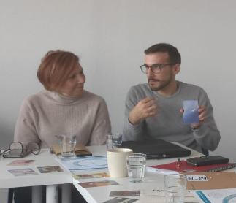
Coaching techniques
Cards/pictures
Ask the client to select 3 cards/pictures that inspire them, speak to them
Good cards: Dixit pictures, random pictures from internet (needs preparation from the coach)
Good to use when the client is lost in defining the goal or the topic

Slide 16
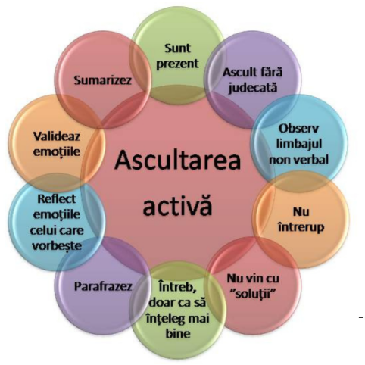
Active listening... What is Active listening for you?
Let the client speak
Rephrase what they are saying, to make sure that you understood correctly, but also to see if they agree with themselves
Search for anchor words
It is better to ask simple question to the point
Mirroring
Listen to emotions, pitch of the voice, speed of the speech, body language

Slide 17
Final do and don’ts
Do
Don’t

Slide 18
Final do and don’ts
Do
Don’t
Create safe space
Clear division between coaching and non coaching
Listen
Believe in your client
Stories and metaphors
Look for different perspectives
Coach if you want to get specific result – that is called manipulation
Coach when not requested*
Try to apply your own situation
judge

